Slide 1

DEPARTMENT OF INFORMATION TECHNOLOGY
Optimizing Information Leakage in Multi cloud Storage Services
PRESENTED BY – Pritish Kshetre
Manthan Jagtap
Ishwar Mhase
Swapnil Jadhav
Class – B.E.(IT)
Academic Year – 2022-23
Project Guide Name H.O.D (IT)
Prof. Ms. S.S. Pophale Dr. D. A.Vidhate
Project Reviewer Name External Guide Name
Dr.D. A.Vidhate

Slide 2
CONTENTS
Title
Problem Statement
Introduction, Objective’s, Motivation
Literature Survey
System Architecture Diagram & Design DFD Diagrams (Level 0, Level 1)
System Overview
Algorithm Details
UML Diagram‘s
Modules
System Requirements (H/W, S/W)
Conclusion
References

Slide 3
PROBLEM STATEMENT
This information leakage problem caused by unplanned data distribution in multi cloud storage services.
Cloud security protects the data, services, virtualized IP, and applications by means of a wide group of technologies, controls, and policies.
But, it has various drawbacks such as loss of control, data loss, unsecured application programming interfaces, etc.
The problem statement of data leakage results sometimes for huge monetary losses to the firm or organization.
The problems might be handled when the leakage source is within the walls of organization. But if the source is somewhere outside the jurisdiction of the firm then it can result as a great threat to the firm.

Slide 4
INTRODUCTION
Cloud computing is the use of computing resources (hardware and software) that are delivered as a service over a network (typically the Internet).
Cloud computing consists of hardware and software resources made available on the Internet as managed third-party services. These services typically provide access to advanced software applications and high-end networks of server computers.
The goal of cloud computing is to apply traditional supercomputing, or high performance, normally used by military and research facilities, to perform tens of trillions of computations per second, in consumer-oriented applications such as financial portfolios, to deliver personalized information, to provide data storage or to power large, immersive computer games.
Cloud Computing comprises three different service models, namely Infrastructure-as-a-Service (IaaS), Platform-as-a-Service (PaaS), and Software-as-a-Service (SaaS).

Slide 5
OBJECTIVES
To optimize the information leakage.
To provide the strategy for optimize data loss.
To protect data from being public.
To enhance the existing optimize system.

Slide 6
MOTIVATION
The goal of cloud computing is to apply traditional supercomputing, or high-performance computing power, normally used by military and research facilities, to perform tens of trillions of computations per second, in consumer-oriented applications such as financial portfolios, to deliver personalized information, to provide data storage or to power large, immersive computer games.
The cloud computing uses networks of large groups of servers typically running low-cost consumer PC technology with specialized connections to spread data-processing chores across them.
This shared IT infrastructure contains large pools of systems that are linked together.

Slide 7
LITERATURE SURVEY
Sr. No. | Title | Publication & Year | Authors | Findings
01 | ON THE DUALITY OF RESILIENCE AND PRIVACY | IEEE ICASI 2018 | J. Crowcroft | To consider the problems of providing resilience against loss, and against unacceptable access as a dual.
02 | A DEPSKY: DEPENDABLE AND SECURE STORAGE IN A CLOUD-OFCLOUDS | IEEE 2019 | A. Bessani, M. Correia, B. Quaresma, F. Andr´e, and P. Sousa | To provide fault tolerance for cloud storage, recent studies propose to stripe data across multiple cloud vendors.
03 | NCCLOUD: A NETWORK-CODING-BASED STORAGE SYSTEM IN A CLOUDOF- CLOUDS | ITASEC 2017 | H. Chen, Y. Hu, P. Lee, and Y. Tang | The increasing popularity of cloud storage services has lead companies that handle critical data to think about using these services for their storage needs.

Slide 8
LITERATURE SURVEY
Sr. No. | Title | Publication & Year | Authors | Findings
04 | SCALIA: AN ADAPTIVE SCHEME FOR EFFICIENT MULTI-CLOUD STORAGE | IEEE ICASI 2018 | T. G. Papaioannou, N. Bonvin, and K. Aberer | In this system, we introduce Scalia, a cloud storage brokerage solution that continuously adapts the placement of data based on its access pattern and subject to optimization objectives, such as storage costs.
05 | SPANSTORE: COST-EFFECTIVE GEO-REPLICATED STORAGE SPANNING MULTIPLE CLOUD SERVICES | IEEE 2019 | Z. Wu, M. Butkiewicz, D. Perkins, E. Katz-Bassett, and H. V. Madhyastha | In this system, we present SPANStore, a key-value store that exports a unified view of storage services in geographically distributed data centers.

Slide 9
SYSTEM ARCHITECTURE DIAGRAM

Slide 10
The architecture of StoreSim is that there is a trust boundary between the metadata and storage servers.
So assume that clients and metadata servers, which are situated inside the trust boundary, are trustable by users while remote servers outside the boundary are not trustworthy.
For example, the metadata can be stored in private database servers while storage servers can be located in public CSPs such as Amazon S3, Dropbox, and Google Drive. Storage servers can be accessed through standard APIs (Application Programming Interfaces).
All control flows are inside the trust boundary while data flows can cross the trust boundary. In order to optimize the information leakage, design two components in StoreSim.
The first component is the Leakage Measure layer (LMLayer), which is used to evaluate the information leakage and generate the storage plan that maps data chunks to different clouds.
The other component is the Cloud Manager layer (CMLayer) which provides cloud interoperability in a syntactic way.

Slide 11
DESIGN DFD DIAGRAMS – LEVEL 0
LOGIN
DATA
INPUT
PROCESS
OUTPUT
ACCESS
AUTHENTICATE DATA
The input design is the link between the information system and the user.
The design of input focuses on controlling the amount of input required, controlling the errors, avoiding delay, avoiding extra steps and keeping the process simple.
The input is designed in such a way so that it provides security and ease of use with retaining the privacy.
A quality output is one, which meets the requirements of the end user and presents the information clearly.
In output design it is determined how the information is to be displaced for immediate need and also the hard copy output.
It is the most important and direct source information to the user.

Slide 12
User Login
DESIGN DFD DIAGRAMS – LEVEL 1
Yes
Check
No
Unauthorized user
User
This system shows the process of the user works.
Firstly the user login, then the system provide authorization.
User can access, select files, split files into multiple parts, upload file to server, view upload file, update file parts, download file, view downloads.
Select File
Split File into Multiple parts
Upload File To Server
View Upload File
Update File Parts
Download File
View Downloads
End process

Slide 13
No
DESIGN DFD DIAGRAMS – LEVEL 1
Cloud Login
Cloud Server
Check
Unauthorized user
Yes
This system shows the process of the cloud server works.
Firstly the cloud server login, then the system provide authorization.
Cloud server manager can access cloud files, user details, downloaded files, Graph.
View Cloud Files
View User Details
View Downloaded Files
Graph
End process

Slide 14
DESIGN DFD DIAGRAMS – LEVEL 1
Meta Data Server
Meta Data Server
This system shows the process of the Meta data server works.
Firstly the Meta data server login, then the system provide authorization.
Meta data server manager can access server file, verify Hash similarity, download details.
Yes
Check
Unauthorized user
No
View Server Files
Verify Hash Similarity
View Downloaded Details
End process

Slide 15
SYSTEM
In this system, we focus on reducing information leakage to each individual CSP in a multi-cloud storage system and provide mechanisms for distributing users data over multiple CSPs in a leakage aware manner.
Firstly provide a novel algorithm for generating similarity preserving signatures for data chunks.
Next based on this algorithm, we decide a chunk placement storage plan that efficiently synchronizes similar chunks together in a multicloud environment.
This system present StoreSim, an information leakage aware multicloud storage system which incorporates three important distributed entities and we also formulate information leakage optimization problem in multicloud.
This system propose an approximate algorithm, BFSMinHash, based on Minhash and Bloom filter to generate similarity-preserving signatures for data chunks. This system also design a pairwise information leakage function based on Jaccard similarity.

Slide 16
ALGORITHM
Algorithm 1:- Bloom-filter Sketch for MinHash
Input: byte[] chunk: byte stream of a data chunk
Output: byte[] signature
1: List<byte[]> shingles = ByteSegment(chunk,size);
2: maxHeap store k smallest values in a max heap
3: for each shingle : shingles do
4: fingerPrint = hashFunction(shingle);
5: maxHeap fingerPrint
6: end for
7: BloomFilter bf; //implement with a single hash function
8: for each fingerPrint : maxHeap do
9: bf.add(fingerPrint);
10: end for
11: byte[] signature = bf.toByteArray();
12: return signature

Slide 17
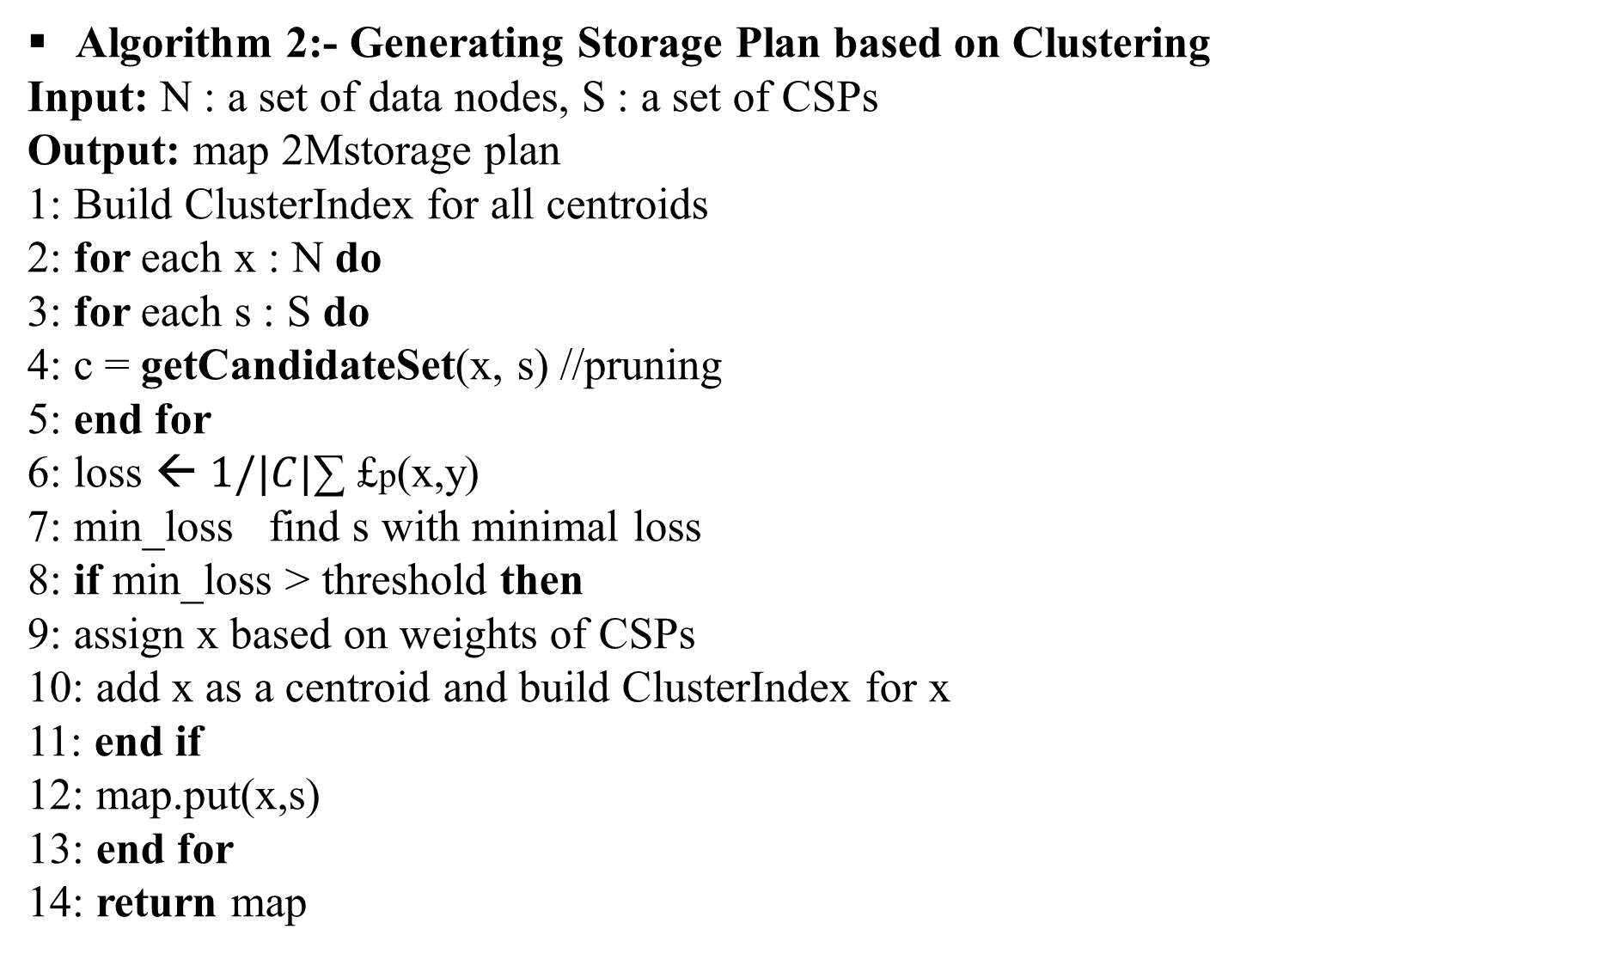
Algorithm 2:- Generating Storage Plan based on Clustering
Input: N : a set of data nodes, S : a set of CSPs
Output: map 2Mstorage plan
1: Build ClusterIndex for all centroids
2: for each x : N do
3: for each s : S do
4: c = getCandidateSet(x, s) //pruning
5: end for
6: loss ← $1/|C|$∑ £p(x,y)
7: min_loss find s with minimal loss
8: if min_loss > threshold then
9: assign x based on weights of CSPs
10: add x as a centroid and build ClusterIndex for x
11: end if
12: map.put(x,s)
13: end for
14: return map

Slide 18
Login
USE CASE DIAGRAMS
Select File
Split File into Multiple Parts
In this system User, Cloud and Meta Data server are the major actor's.
This system provides the overview of the user, cloud and meat data server relationship.
As it shows the dependency and the work or responsibility of each actor.
This system shows the control panel of the cloud and meta data server.
Every transaction or interaction of user with the system is monitor or controlled with security and transparency by the cloud and the meta data server.
Upload File
User
View Uploaded Files
Cloud
Update File Parts
Download Files
View Cloud Files
View User Details
Verify Hash Similarity
View Download Details
Meta Data Server
Logout
Logout

Slide 19
ACTIVITY DIAGRAMS
Start
User
Cloud
Meta Data Server
In this system the flow of action is shown.
This flow of action gives full overview.
This system shows the activity of the action
performed by the independent entity.
As it shows from start point to end point.
This system shows whole timeline of the user,
cloud, meta data server actions.
LOGIN
LOGIN
LOGIN
Select file, Split file into multiple parts, Upload file, View uploaded files, Update file parts, Download files, View downloaded details.
View cloud files, View user details, View downloaded details, Graph.
View cloud files, Verify hash similarity, View downloaded details.

Slide 20
SEQUENCE
DIAGRAMS
SERVICE
User
Meta Data Server
Cloud
In this system the communication between the entity's is shown.
The system states the communication channel from the user to the service.
This system direct the communication of the user, cloud, meta data server.
This system shows timeline or sequence of the user's every query session.
Select File
Split File into Multiple Parts
Upload File
View Uploaded Files
Update File Parts
Download Files
View Cloud Files
Verify Hash Similarity
View Downloaded Details
DATA BASE

Slide 21
Data User
Data Owner
Data User
CLASS
DIAGRAMS
Data Owner
Login
Login
Login
Login
Upload Files ()
View Uploaded Files ()
View File Request by Users ()
Approve File Request ()
Update File Parts ()
Download File ()
View Download Files ()
View Files uploaded by Data
Owners()
View Downloaded Details ()
Send File Request ()
Graph ()
Verify key Sent by data Owner ()
View requested File()
Upload Files ()
View Uploaded Files ()
View File Request by Users ()
Approve File Request ()
This system shows the short term idea of each entity.
This system shortly state the brief of the system entities.
This system shows operation, procedure, job role of the entities.
Cloud
Login
View User Details ()
View Cloud Files ()
View Owners Details ()
Verify Hash Similarity ()
View Uploaded Files on Cloud
View Downloaded Details ()
Server()
Cloud
Login

Slide 22
MODULES
Client:
Client is in charge of pre-processing the users’ data for the purpose of optimization, such as chunking (i.e., dividing files into individual chunks of a maximum size data unit), duplication(i.e., avoiding storing and re-transmitting the same content already available on the remote servers), delta encoding (i.e., transmission of only modified portions of a file), bundling(i.e., the transmission of multiple small files as a single object) and encryption/decryption.
2. Metadata server:
Metadata servers are used to store the metadata database about the information of files, CSPs and users, which usually are structured data representing the whole cloud file system;

Slide 23
MODULES
3. Storage server:
Storage servers store the raw data blocks which can be both structured and unstructured data.
DriveHQ cloud service provider is used for uploading the data in the Cloud
4. Signature Generation:
The file’s contents can be uniquely identified by this list of hashes and call these hashes as signatures.
To synchronize the updates to the cloud, the client will firstly send the signatures of current file to the metadata server.
Then, the metadata server will detect these modified chunks by comparing current signatures with the signatures of last version and only returns the signatures of these changed chunks to the client.
Finally, the client will only upload these chunks with changed signatures to the storage server. This design system is based on sync-like protocols and further optimize the system in terms of information leakage.

Slide 24
SYSTEM REQUIREMENTS
Hardware Requirements
Software Requirements
System : Intel i3 2.4 GHz.
Hard Disk : 128GB.
Monitor : 15” VGA Colour.
Mouse : Logitech.
RAM : 2GB.
Operating system : Windows 7.
Coding Language : JAVA
Data Base : MYSQL
IDE: NetBeans 8.2

Slide 25
CONCLUSION
Most of the people are storing their data over the multiple clouds for security purpose.
However, unplanned distribution of data over the multiple clouds may produce the probability to loss all data, which increase degree of information leakage in multi cloud.
To optimize information leakage, this system provided StoreSim system, which is a storage system, that aware information loss in multiple clouds and storing the similar data to same cloud.
This system designed MinHash algorithm to efficiently generate similarity-preserving signatures for data chunks and designed a function to compute the information leakage based on these signatures which are hashed by fingerprint algorithms such as SHA-1, MD5.
Finally, this system provided the optimal multi cloud storage providers which used to minimize information leakage efficiently.

Slide 26
REFERENCES
J. Crowcroft, “On the duality of resilience and privacy,” in Proceedings of the Royal Society of London A: Mathematical, Physical and Engineering Sciences, vol. 471, no. 2175. The Royal Society, 2015, p. 20140862.
A. Bessani, M. Correia, B. Quaresma, F. Andr´e, and P. Sousa, “Depsky: dependable and secure storage in a cloud-of-clouds,” ACM Transactions on Storage (TOS), vol. 9, no. 4, p. 12,2013.
H. Chen, Y. Hu, P. Lee, and Y. Tang, “Nccloud: A network-coding-based storage system in a cloud-of-clouds,” 2013.
T. G. Papaioannou, N. Bonvin, and K. Aberer, “Scalia: an adaptive scheme for efficient multicloud storage,” in Proceedings of the International Conference on High Performance Computing, Networking, Storage and Analysis. IEEE Computer Society Press, 2012, p. 20.

Slide 27


